Slide 1


Origin of the band gap for ionic materials : a data driven approach
Abstract
The band gap (E_{g}) is one of the crucial parameters in the determination of the thermoelectric (TE) performance of a semiconducting material. Herein, we present a data driven investigation of the origin of the band gap and its linkage to elemental properties, mainly electronegativity. By leveraging upon the abundance of data available in the Materials Project (MP) database, we found 10 new chalcogenide based compounds with narrow band gap and possibly low thermal conductivity. These compounds could be very suitable for near room temperature (RT) cooling applications.
Author: Jose Recatala Gomez

Slide 2
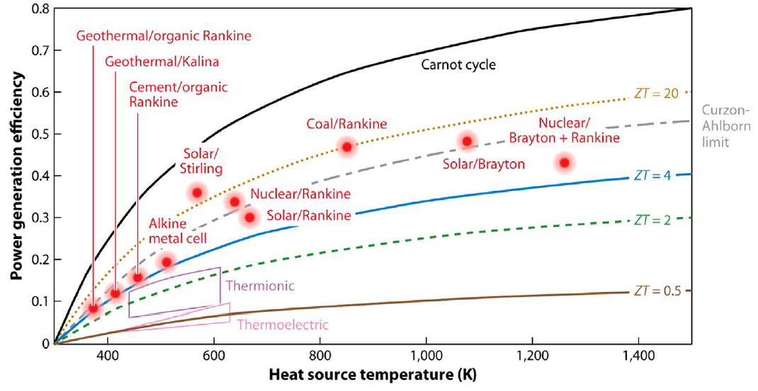

Motivation
TE Performance
The performance of TE materials is low in comparison with other technologies. A better performance can only be achieved by the synergistic enhancement of the components of the dimensionless figure-of-merit zT = S²σT/κ
Efficiency (η)
zT
S²σ
κ ⁻¹
$$S_{max}= \frac{E_{g}}{2eT_{max}}$$
E_{g}
Valid for degenerate semiconductors in bipolar regime
1. He et. al. Science 357, 1369 (2007)
2. H. J. Goldsmid et. al., J. Electron. Mater. 28, 869–872 (1999)
3. Gibbs, Zachary M., et.al, Applied Physics Letters 106, 2 (2015)
The E_{g} will determine S_{max}, which in turn will determine zT_{max}

Slide 3
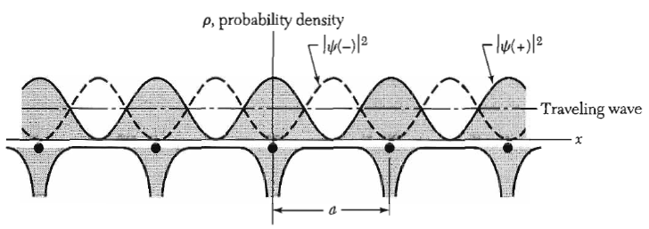
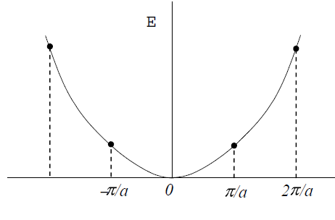
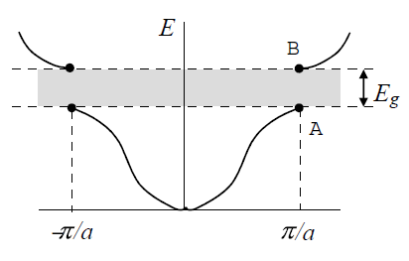

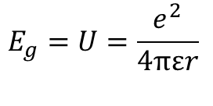

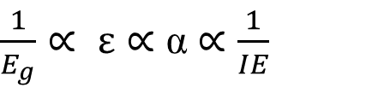
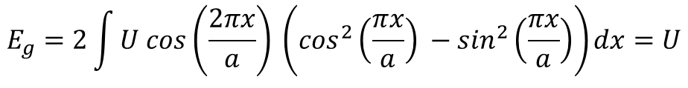
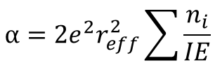

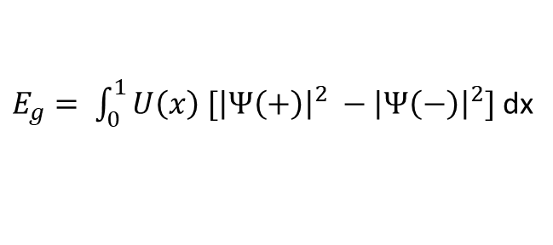



Band gap: main origin
U = 0
U ≠ 0
$$+$$
$$2 cos\left(\frac{πx}{a}\right)$$
$$Ψ\left(±\right)=\exp\left(\frac{iπx}{a}\right)±\exp\left(\frac{−iπx}{a}\right)=⁡$$
Clausius-Mossotti relation
$$−$$
$$2i sin\left(\frac{πx}{a}\right)$$
$$\frac{ε_{r}−1}{ε_{r}+2}=\frac{nα}{3ε_{o}}$$
$\frac{1}{E_{g}}∝ ε∝$ α $∝\frac{1}{IE}$
$E_{g}= \int_{0}^{1}{U\left(x\right) [{\left|Ψ\left(+\right)\right|}^{2} −{\left|Ψ\left(−\right)\right|}^{2}]}$ dx
$$α=2e^{2}r_{eff}^{2}\sum{\frac{n_{i}}{IE}}$$
$$E_{g}=2\int{U cos\left(\frac{2πx}{a}\right) \left(\cos^{2}\left(\frac{πx}{a}\right) −\sin^{2}\left(\frac{πx}{a}\right)\right)dx}=U$$
$$E_{g}=U=\frac{e^{2}}{4πεr}$$
For ionic solids, the band gap (crystal potential, U) is directly proportional to the polarizability (α) and inversely proportional to the ionisation energy (IE)
4. C Kittle, Introduction to Solid State Physics
5. Dimitrov et. al. Journal of Solid State Chemistry 196 (2012) 574–578

Slide 4
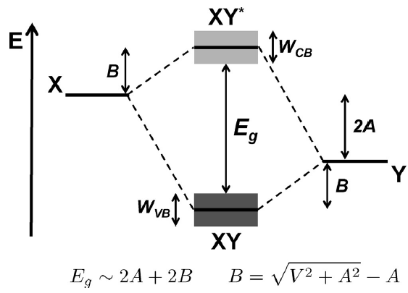

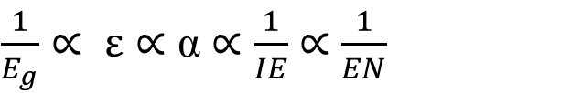
Band gap: correlation with electronegativity
E
0
Electronegativity (EN): the power of an atom in a molecule to attract electrons to itself
Ionisation Energy (IE): energy required to remove an electron from a neutral atom in its gaseous phase
EA
$EN (χ$) *
6. Pauling, L., J. Chem. Educ., 1992, 69 (7), p 519
IE
E_{C}
E_{F}
E_{V}
6. Zeier, W.G et. al. Angewandte Chemie International Edition, 55(24), pp.6826-6841
We can use IE as metric, but we can also use EN (which will give additional information regarding the bonding)
$\frac{1}{E_{g}}∝ ε∝$ α $∝\frac{1}{IE}$ $∝$ $\frac{1}{EN}$
Direct correlation between E_{g} and EN is expected
*EN in Pauling scale

Slide 5
Problem Statement
Can we, through a data-driven approach, find materials that have low EN to find narrow E_{g} materials for near room temperature TE?

Slide 6


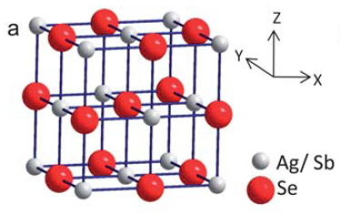
Methodology
Screening criteria:
0.16 ≥ E_{g} ≤ 4 eV
E_{hull} = 0
Must contain a chalcogenide (S, Se, Te)
High symmetry compounds: ≥ 4 symmetry operations
Due to inaccuracies intrinsic to the dataset, a strict screening criteria is set
Materials Project is an open database whose goal is the democratisation of knowledge by compiling diverse theoretical data (elasticity, band structures and band gaps …)
Data mining with Matminer
7.A. Jain et. al. APL Materials, 2013, 1(1), 011002.
8. Ward, L et. al. Comput. Mater. Sci. 152, 60-69 (2018).
58 S based chalcogenides
41 Se based chalcogenides
23 Te based chalcogenides
Focused on ABX₂ chalcogenides
Historically, good TE materials
Form a large subset of available data on materialsproject.org
Dataset
Guin et. al Energy Environ. Sci., 2013,6, 2603-2608

Slide 7
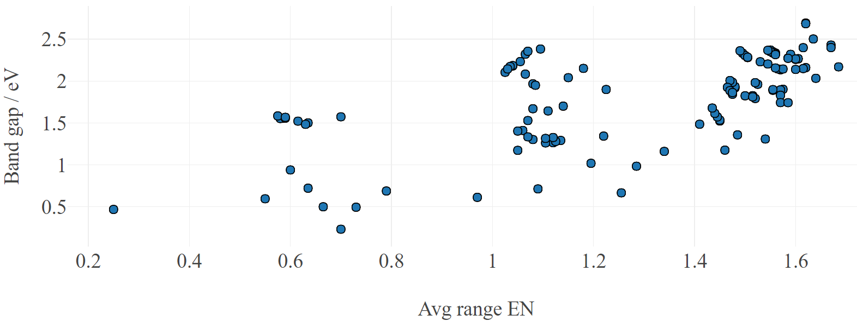
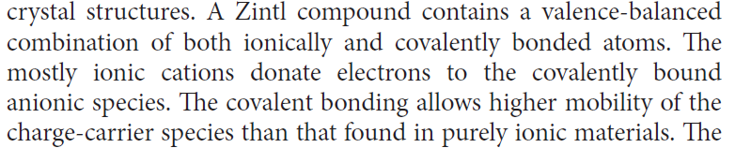
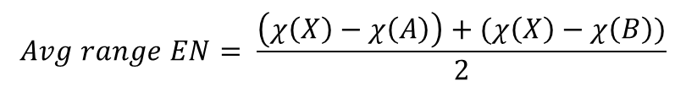
Results: ABX₂ compounds with trigonal structure and space group of 166
We define a new, more meaningful way to express the electronegativity in ABX₂ ternary chalcogenides, the average range EN:
$$Avg range EN= \frac{\left(χ\left(X\right)−χ\left(A\right)\right)+(χ\left(X\right)−χ\left(B\right))}{2}$$
This metric is an indicator of the nature of bonding in the materials
Limit of low Avg range EN → Covalent bonding
Limit of high Avg range EN → Ionic bonding
Expected trend (Clausius-Mossotti)
GdTlTe₂
AgBiSe₂
TlInS₂
TlBiTe₂
CrAuS₂
ScTlSe₂
KGdTe₂
NaCrSe₂
AgBiS₂
TlBiSe₂
Compounds with E_{g} < 1 eV will show S_{max} near room temperature
From: 9.Snyder, G. J. et. al. Nat. Mater. 7, 105–114 (2008).

Slide 8
Analysis and hypothesis
The lower the electronegativity difference, the narrower the band gap and the more covalent the bonding
Conclusions
Successful data-driven discovery in the family of ABX₂ (X = S, Se, Te), where preliminary results for a few compounds are available, but other materials within this family remain unexplored
Our study recommends 10 unexplored compounds as potential candidates for near room temperature thermoelectric applications

